Slide 1
Cyclistic Riders comparison

Slide 2
Background
Cyclistic's future success depends on maximizing number of memberships.
The strategy is to convert causal rider to annual member.
Notes:
Consider talking about:
Etymology
19th century
20th century
21st century

Slide 3
Guiding Questions
How do annual members and casual riders use Cyclistic bikes differently?
Why would casual riders buy Cyclistic annual memberships?
How can Cyclistic use digital media to influence casual riders to become members?
We will answer the first of the three questions:

Slide 4
Business Tasks
Compare between Casual and annual members:
How many rides per month? How are they trending in time? By season, by hour of day and by day of week
How different are the ride durations?
How different are usages by locations?

Slide 5
Data Source
The data comes from divvy's website (though Cyclistic is a fictional company). This website link provides information and licensing of the data. The data is open sourced and for public use. https://ride.divvybikes.com/system-data
Notes:
Consider talking about:
Notable landmarks

Slide 6
Data Schema
ride_id object
rideable_type category
started_at datetime64[ns]
ended_at datetime64[ns]
start_station_name category
start_station_id category
end_station_name category
end_station_id category
start_lat float64
start_lng float64
end_lat float64
end_lng float64
member_casual category
Notes:
Consider talking about:
Fire Department
Diplomatic missions

Slide 7
Data Cleaning
These data rows are excluded from analysis:
rows with null data
rows with trip start time greater than trip stop time
rows where station ids with lat/lng anomaly
rows with "Temp" in station names indicating test trips
rows with durations anomaly (one trip was almost one month)
Notes:
Consider talking about:
Local
State
Federal

Slide 8
Ride Count Analysis
Notes:
Consider talking about:
Local
State
Federal

Slide 9
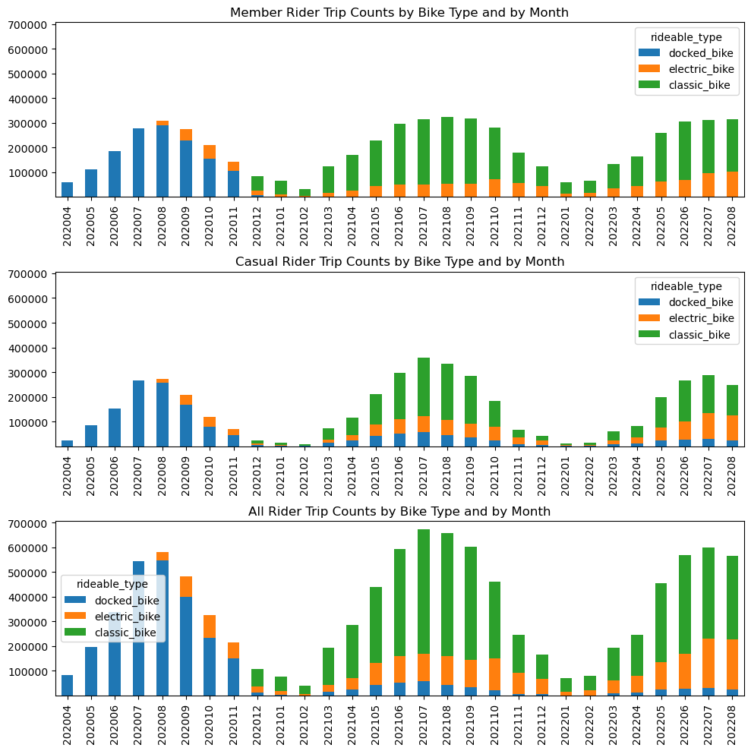
Ride Counts Trend by Bike Type
Observations:
Docked_bike was initially the only bike type but is getting phased out. Classic_bike becomes most popular but electric_bike is gaining popularity.
It is surprising that annual member which I perceive as commuters choose to use classic bike over electric. Need to explore further on the motivation of choosing bike types such as bike for health/ leisure, or cost/ availability factors.
The number of rides corresponds to seasons. The rides peaked in July and August months and are lowest during December through February. The casual and member rides counts are similar at peak time but they differ more during low months.
The ride counts have not increased through the years and casual riders are reduced this year.

Slide 10
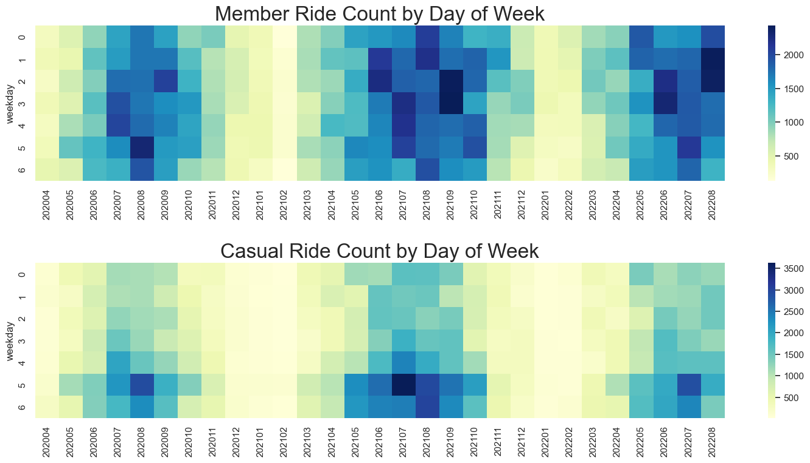
Ride Counts by Day of Week
The two figures use different scales for observing contrasts.
Casual riders take more rides during weekend. Members take less rides during weekend.

Slide 11
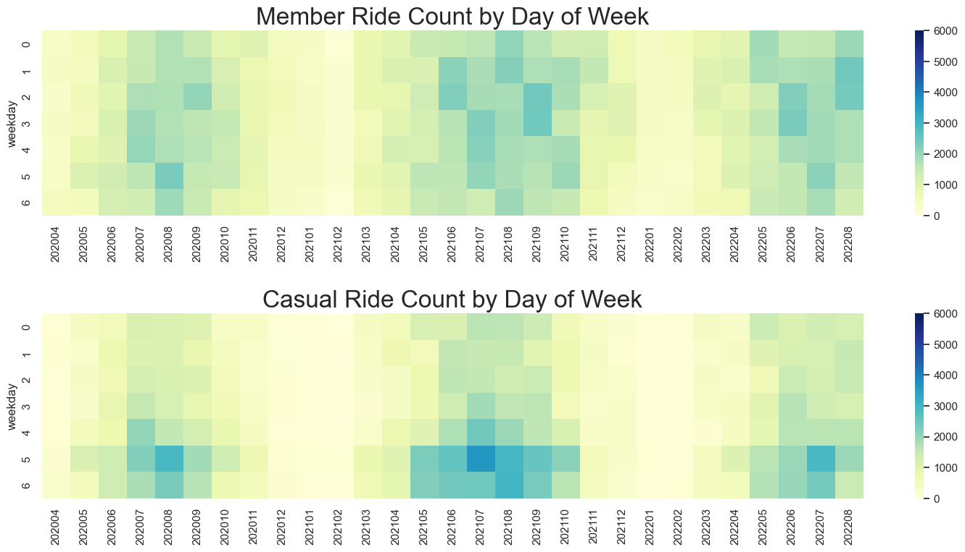
Ride Counts by Day of Week (same scale)
The two figures use the same scale for observing diffs.
There are good number of rides by both member and casual riders during non commute hours. That means riders are well adapted to bike sharing as transportations.

Slide 12
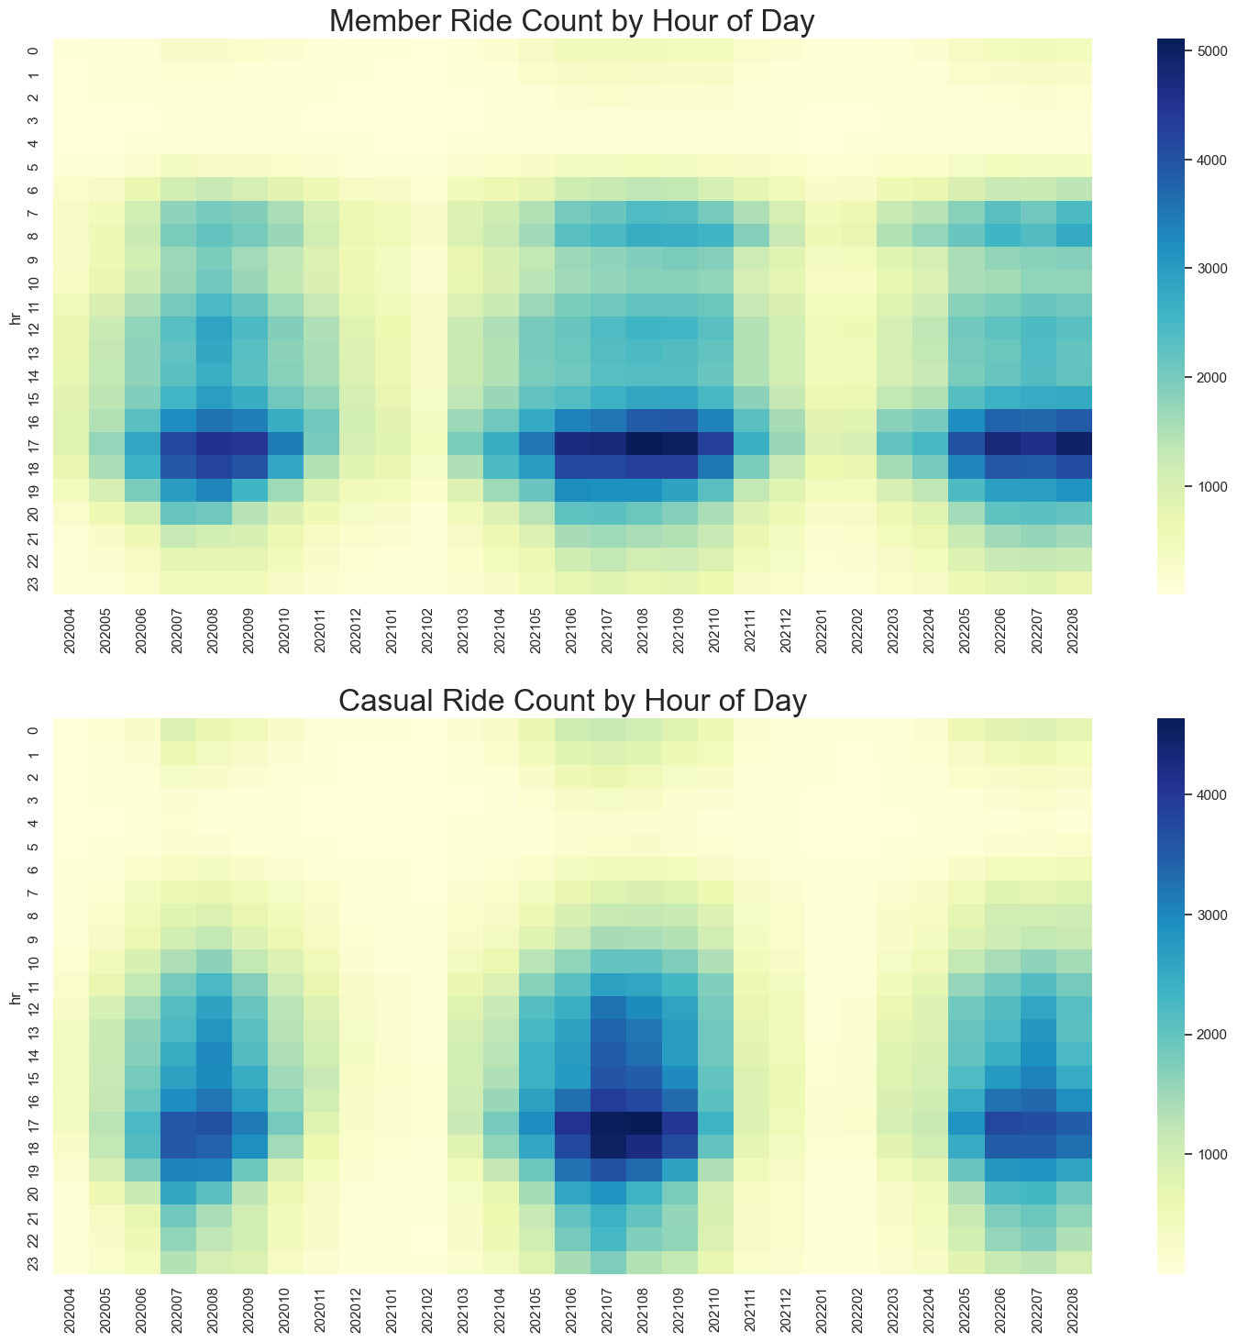
Ride Counts by Hour of Day
The two figures use different scales for observing contrasts.
As expected, member ride counts are most heavy during 6-7 am and 4-6 pm due to work commute. Somewhat heavy during lunch hour.
Casual rides also peak in the afternoon. It is likely they will need to compete the use of the bikes with the commuters. The thought is if membership offers some special benefit during this peak time, they may want to convert.

Slide 13
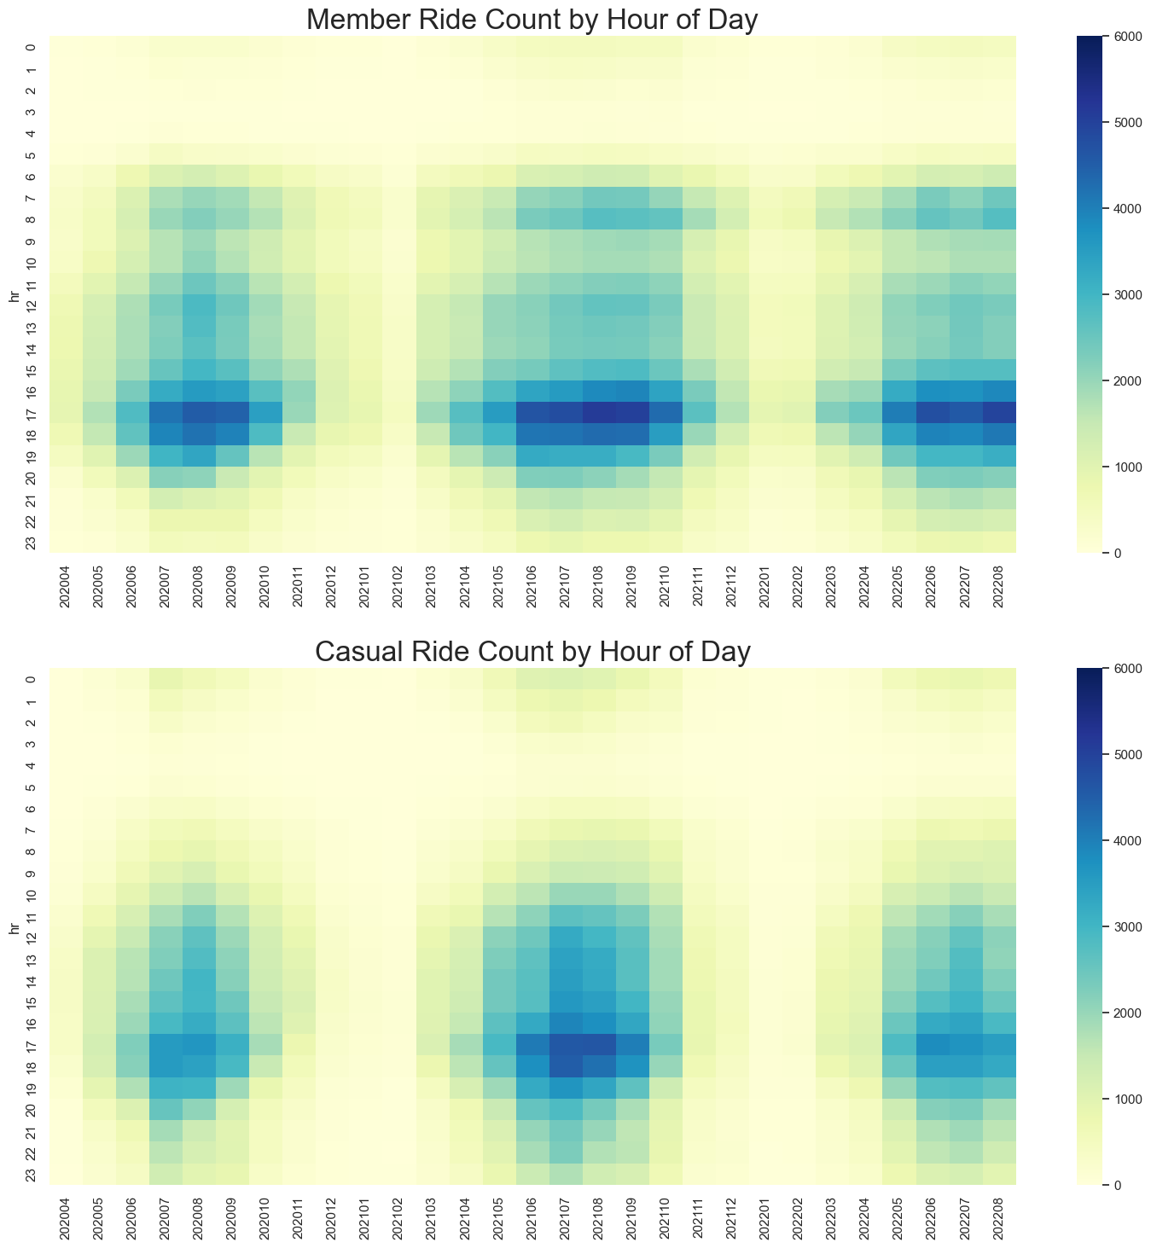
Ride Counts by Hour of Day
The two figures use the same scale for observing diffs.
We see casual rides cover throughout the day at similar scale except morning commute time. Maybe casual rider don’t like to fight morning commuters.
We see casual and member have the same peak hours in the afternoon.

Slide 14
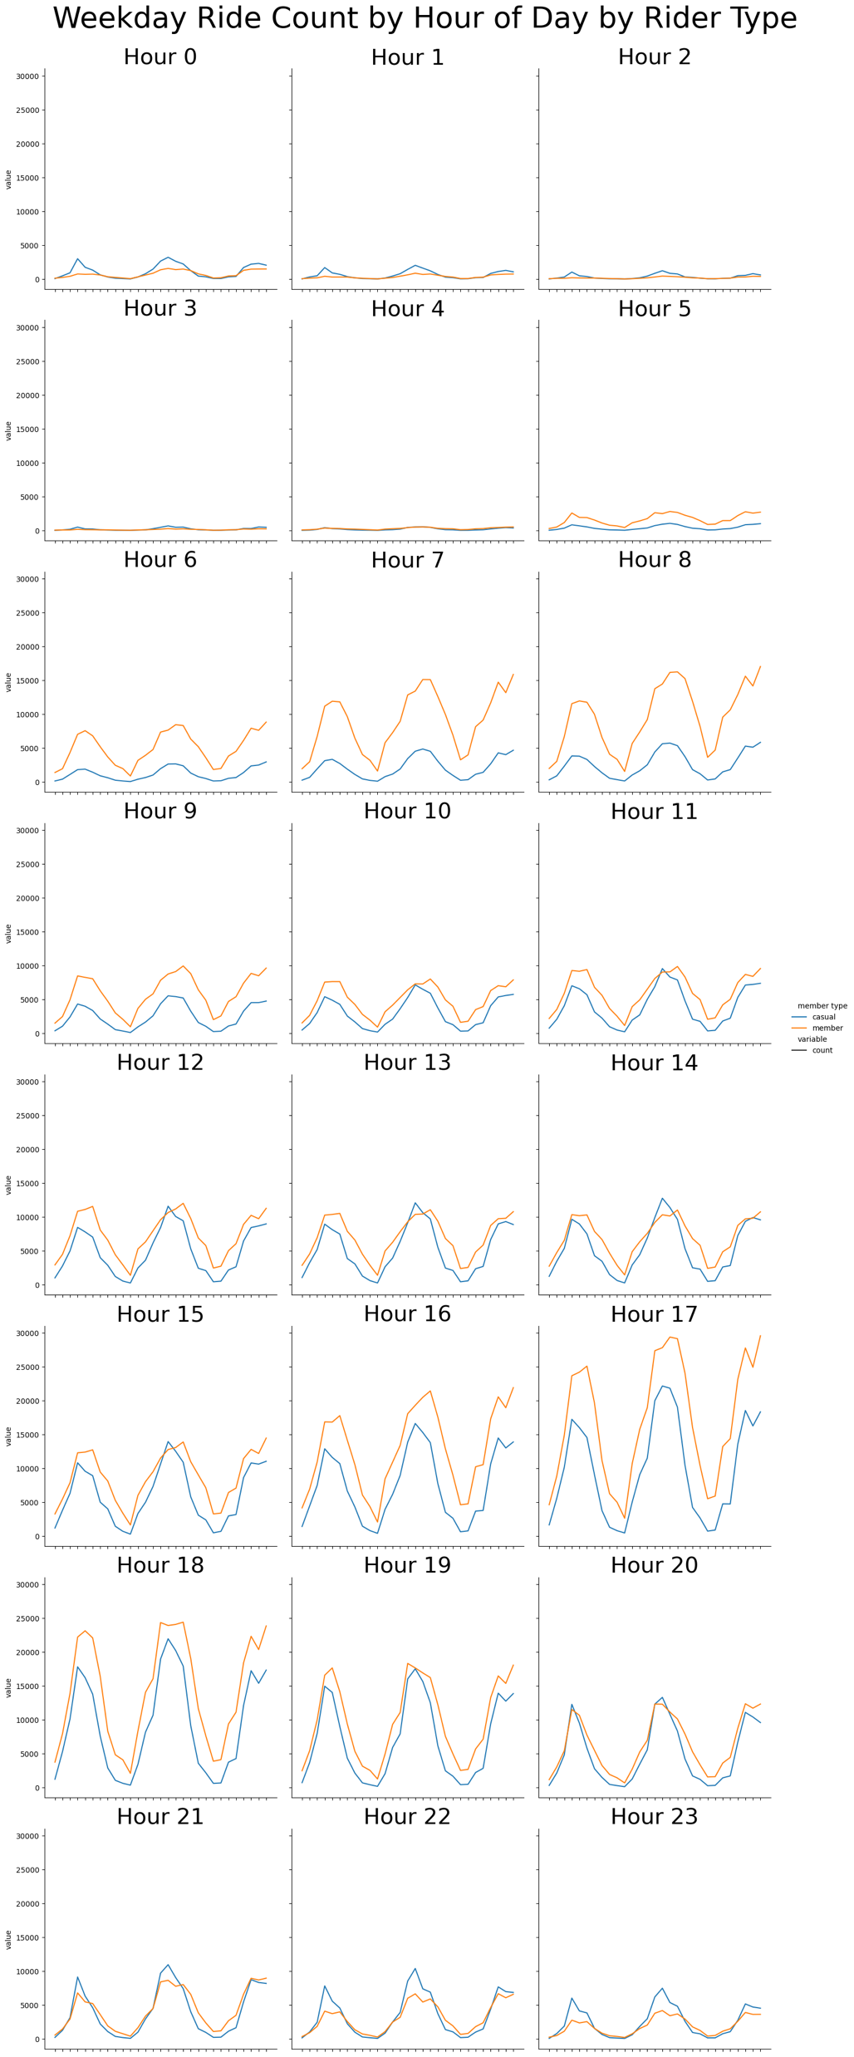
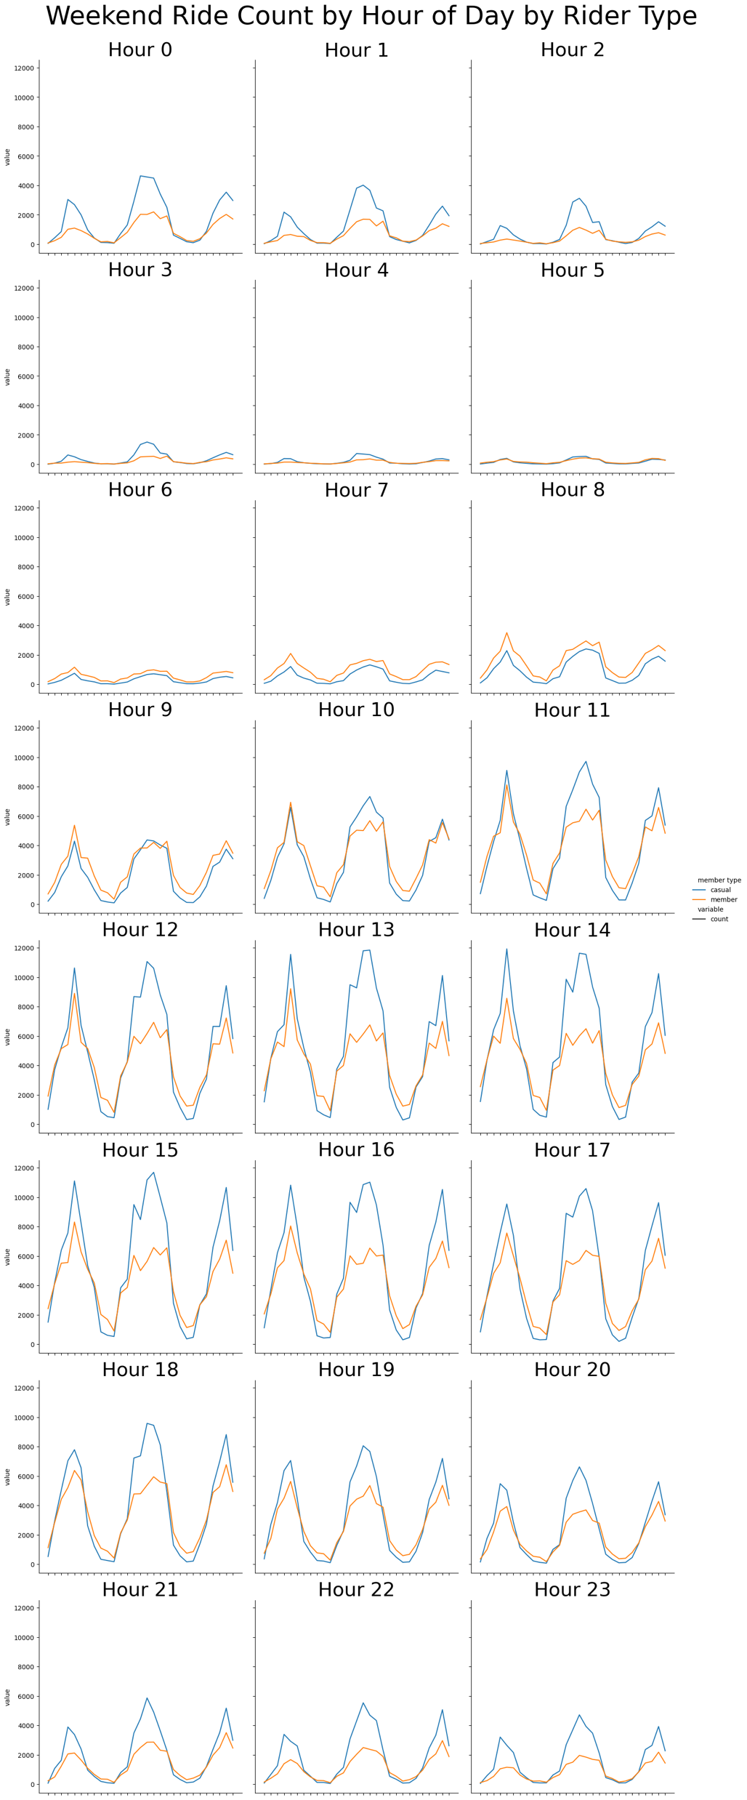
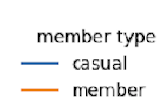
Ride Counts by Hour of Day comparing weekday and weekend
We see casual rides are more than member rides during the weekend.
Since it is a lifestyle thing for casual riders to take leisure trips during weekend, consider giving weekend promotions for members.

Slide 15
Ride Duration Analysis
Notes:
Consider talking about:
Chicago Riverwalk
Grant Park
Maggie Daley Park
Millennium Park
Printer's Row Park
Pritzker Park
Theodore Roosevelt Park

Slide 16
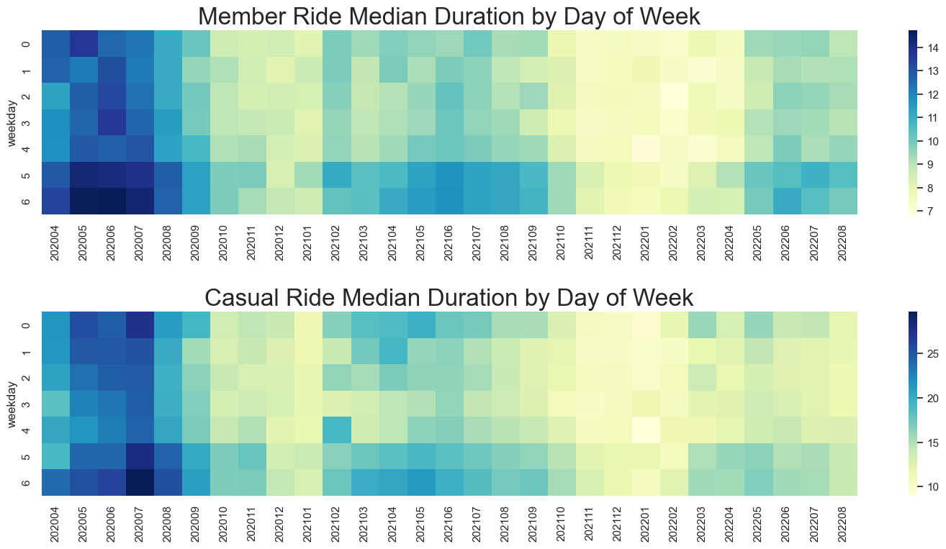
Ride Duration by Day of Week
The two figures use different scales for observing contrasts.
During weekends, both casual and member take longer trips than during weekdays.
We also observe the seasonality that colder months correspond to shorter the trips.

Slide 17
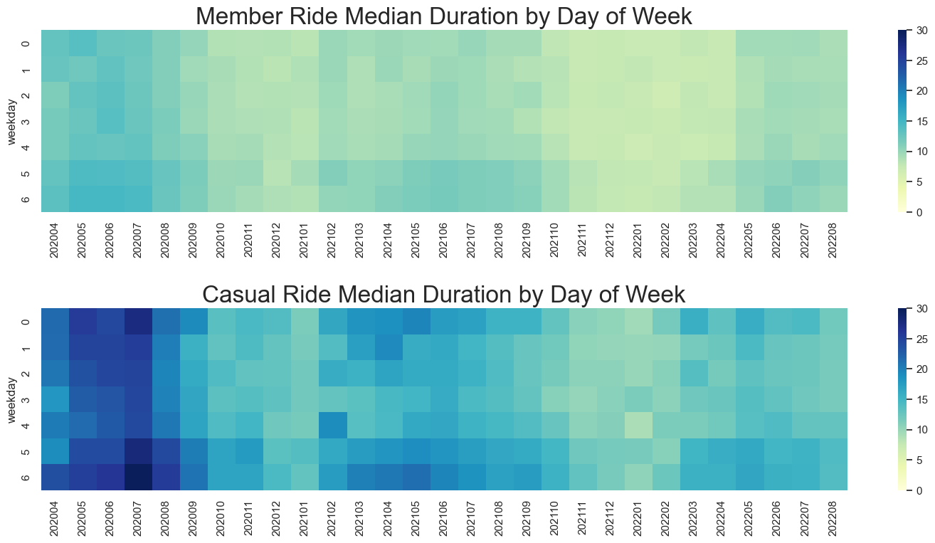
Ride Duration by Day of Week
The two figures use the same scale for observing diffs.
In general, casual riders take longer trips than members.

Slide 18
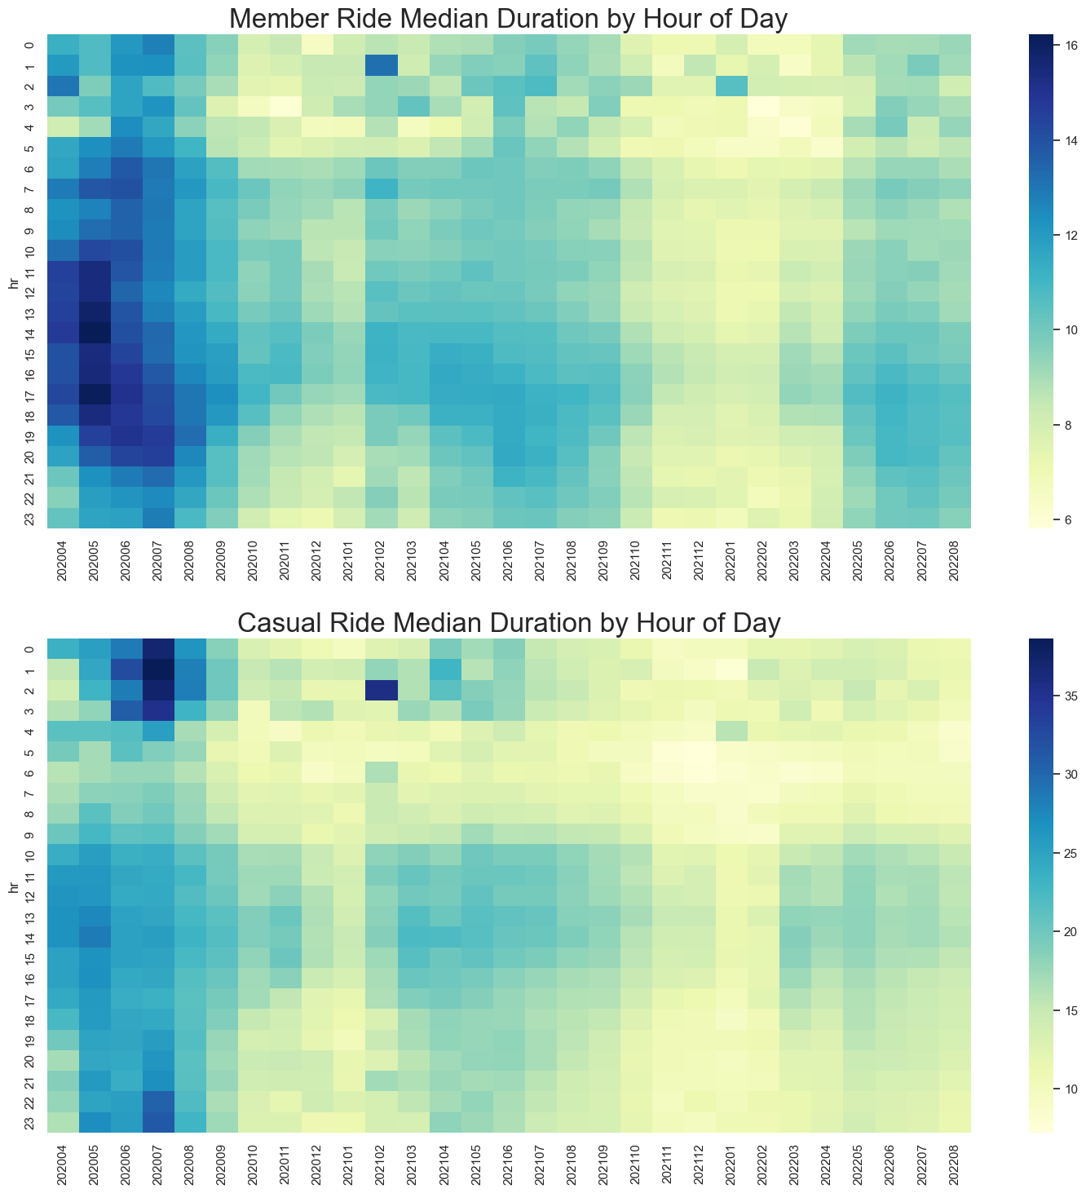
Ride Duration by Hour of Day
The two figures use different scales for observing contrasts.
Durations are shortest at 3-5am for members and 4-8am for casual riders.
Durations are longest at 4-6pm for members and 2-5pm for casual riders.

Slide 19
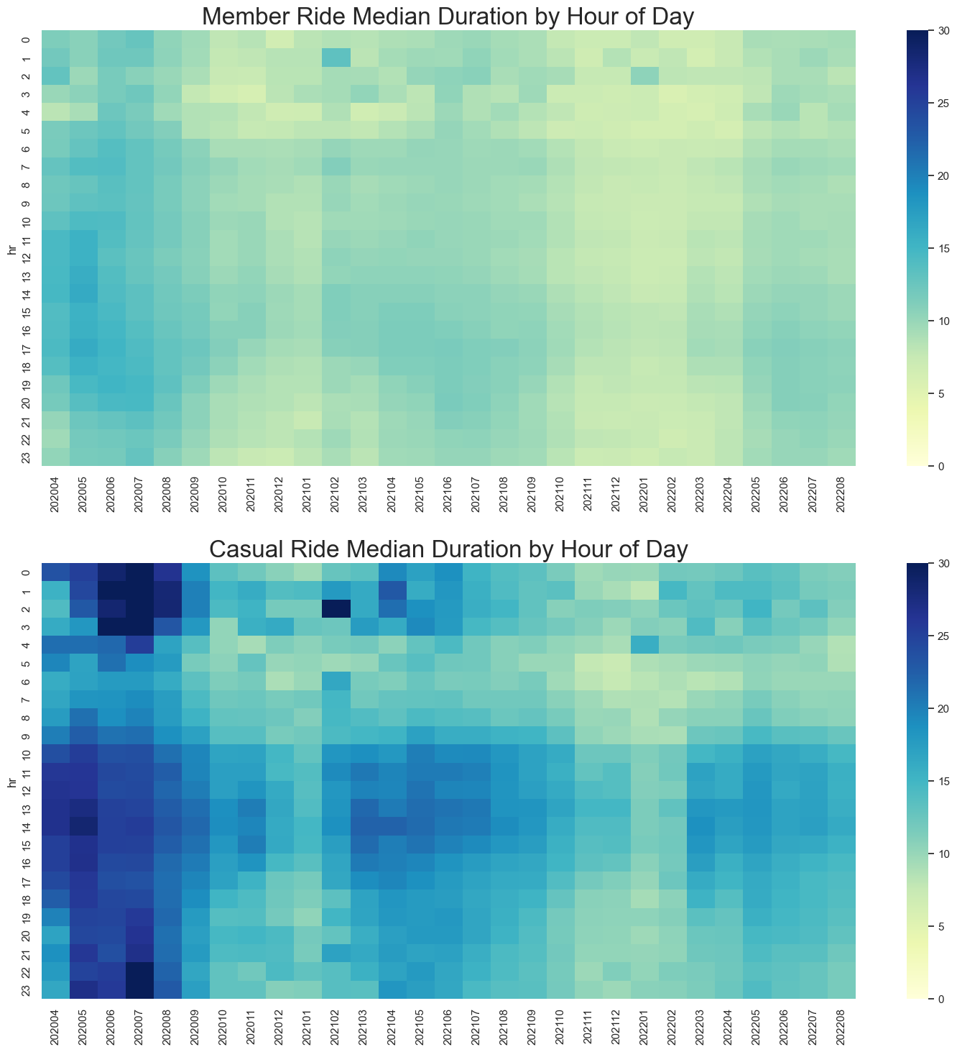
Ride Duration by Hour of Day
The two figures use the same scale for observing diffs.
Again, in general, casual riders take longer trips than members.

Slide 20
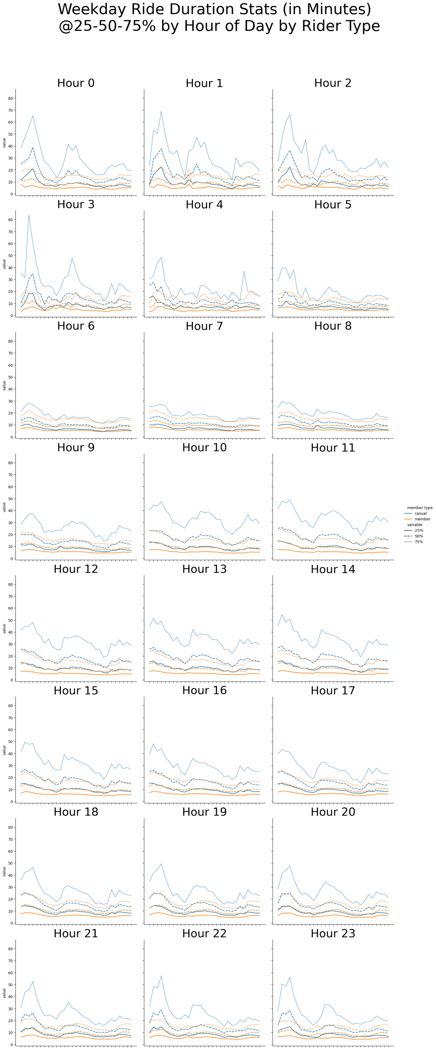
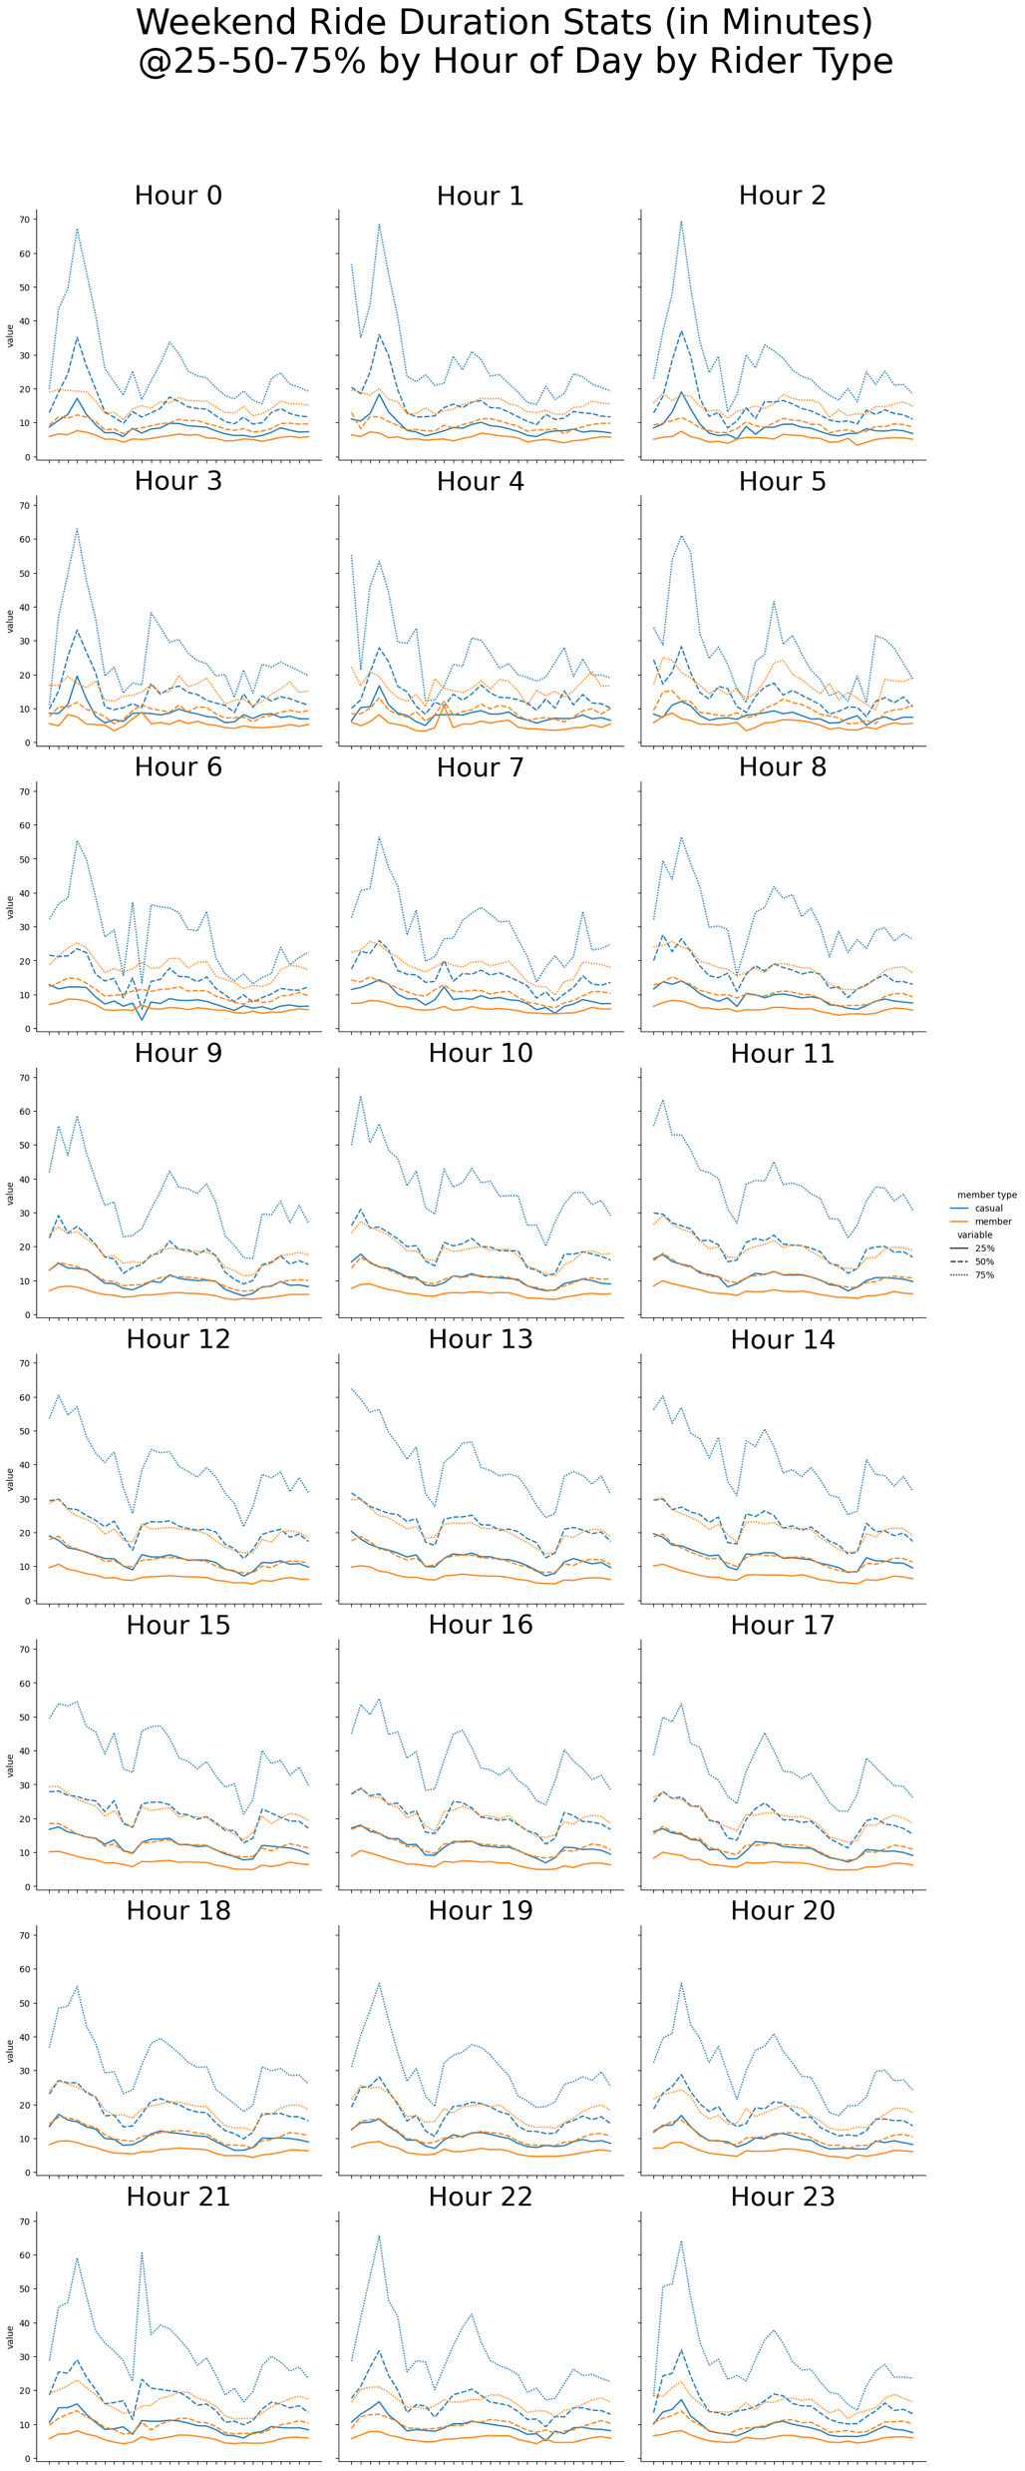
Ride Duration by Hour of Day comparing weekday and weekend
We see casual rides are longer even during weekdays.
Since it is a lifestyle thing for casual riders to run long trips frequently during weekend, consider giving discounted rate or day pass for members.

Slide 21
Map Views
Notes:
Consider talking about:
Chicago Riverwalk
Grant Park
Maggie Daley Park
Millennium Park
Printer's Row Park
Pritzker Park
Theodore Roosevelt Park

Slide 22
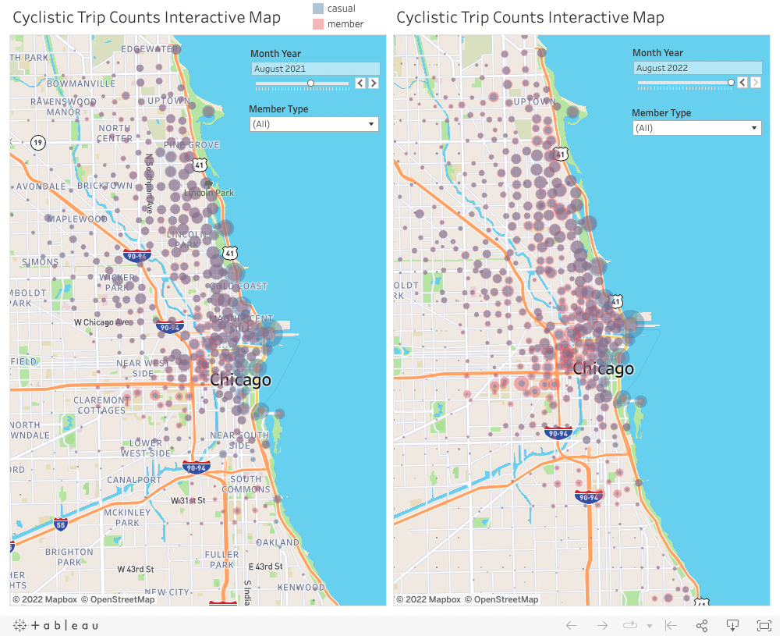
Tableau Interactive Map

Slide 23
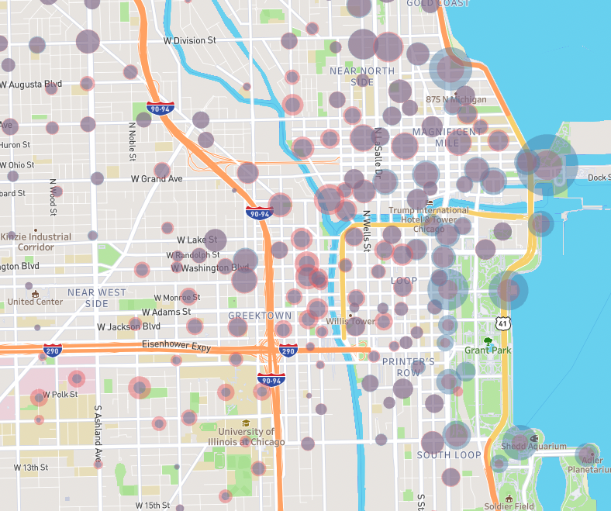
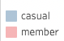
Busy Stations
It is very clear that bike traffic is densest near Chicago harbor. One great example is at Streeter and Grand Ave.
Some areas with great member/casual ratio like Greek Town, U of Illionis at Chicago and South Commons can be good member conversion zone. It can be helpful to identify demographic information by regions to further analyze the local characteristics.

Slide 24
Some Additional Thoughts
Though it is beyond scope to analyze locational demographics and ride profiles of users. It can be a significant factor in deciding which user group to covert to membership.
We also want to rationalize whether we want to convert riders from locations/demographics with highest casual/member ratio (more rider candidates to promote membership), or locations with lowest casual/member ratio (this could mean, the demographics are most benefited by ride share membership). There should be difference strategies to approach the two groups for member conversion.
Since our focus is on converting casual to member riders, we need to examine further if some casual riders can benefit from membership from the aspect of saving money or conveniences.
From the popularity of ridership for casual riders during the peak hours of the days, we conclude that using bike as transportation is very relevant to the riders' needs. However, I think the best is to collect some surveys from casual users who use the bikes frequently to find out their pain points.

Slide 25
Summary
Ride counts from both casual and member riders are similar. This means it is good idea to try to gain membership through conversion.
The ride counts have not increased through the 2+ years and casual rider’s count has reduced this year. If possible, further analysis is needed to find out competing factors.
Casual riders take most rides during weekend. Members take less rides during weekend. Some incentives for weekend travel for member may help with conversion.
Casual rides also peak 4-7pm. This should be a key behavior to further investigate. It is likely they will need to compete the use of the bikes with the commuters. If membership offers some special benefit during these peak time, it may help with conversion.
We see casual rides cover throughout the day at similar scale except morning commute time. Maybe casual rider don’t like to fight morning commuters.
In general, casual riders take longer trips than members. Since it is a lifestyle thing for casual riders to run long trips frequently during weekend, consider giving discounted day pass for members
Notes:
Consider talking about:
Chicago Riverwalk
Grant Park
Maggie Daley Park
Millennium Park
Printer's Row Park
Pritzker Park
Theodore Roosevelt Park

